Slide 1
STARTING INDONESIAN RESTAURANT IN TRAFFORD, GREATER MANCHESTER, ENGLAND
By Dimas Buntarto

Slide 2
INTRODUCTION
Indonesian cuisine is one of the richest culinary traditions in the world
It is full of strong flavors.
We will try to find an optimal location for a restaurant
We will try to detect locations that are not already crowded with restaurants.
We are also particularly interested in areas with no Indonesian restaurants in vicinity

Slide 3
DATA
Factors that will influence our decission are:
Number of existing restaurants in the neighborhood (any type of restaurant)
Number of and distance to Indonesian restaurants in the neighborhood, if any
Restaurant density in the neighborhood

Slide 4
DATA
Needed to extract/ generate the required information:
Centers of candidate areas will be generated algorithmically and approximate addresses of centers of those areas will be obtained using Google Maps API reverse geocoding.
Number of restaurants and their type and location in every neighborhood will be obtained using Foursquare API
Coordinate of Trafford center will be obtained using Google Maps API geocoding.

Slide 5
METHODOLOGY
Collecting the required data: location and type (category) of every restaurant.
Calculate and exploration of 'restaurant density' across different areas of Trafford
Focus on most promising areas

Slide 6
RESULT – TRAFFORD’S NEIGHBOORHOOD
No | Borough | Centre | Neighborhood | Lat | Long
1 | Trafford | Stretford | Altrincham | 53.38397 | -2.35255
2 | Trafford | Stretford | Bowdon | 53.37688 | -2.37153
3 | Trafford | Stretford | Hale | 53.37852 | -2.34750
4 | Trafford | Stretford | Sale | 53.42449 | -2.31842
5 | Trafford | Stretford | Urmston | 53.44832 | -2.35366
6 | Trafford | Stretford | Partington | 53.42148 | -2.42825

Slide 7
RESULT – NUMBER OF RESTAURANT
No | Neighborhood | No. of Restaurant | No. of Indonesian Restaurant
1 | Altrincham | 10 | -
2 | Bowdon | - | -
3 | Hale | 9 | -
4 | Sale | 4 | -
5 | Urmston | 4 | -
6 | Partington | - | -

Slide 8
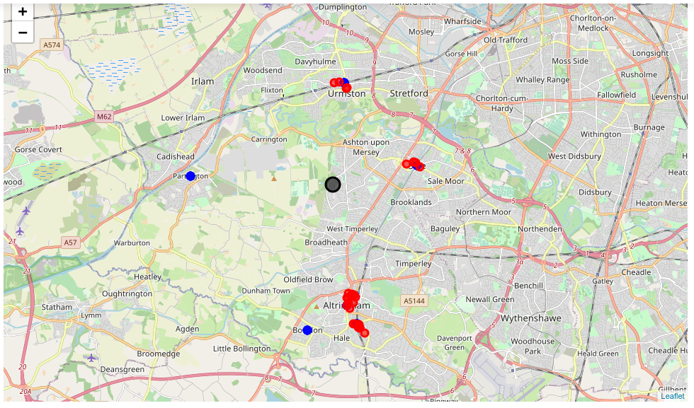
RESULT – RESTAURANT DENSITY

Slide 9
CONCLUSION
Final decission on optimal restaurant location will be made by stakeholders based on specific characteristics of neighborhoods and locations, and we suggest opening an Indonesian restaurant in the Parlington area

